Slide 1
Computer Management Part 2

Slide 2
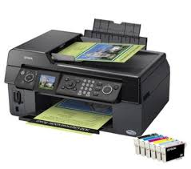
Print Management
Adding new peripheral such as a printer usually connects via a USB port.
First install the cd that came with the Printer or you can go to the Control Panel, Printers and Faxes and then choose Add Printer. Using the wizard it will guide you through the installation

Slide 3
Why changing the Default Printer
Why do you want to change the default of a printer ?
Let say you have a colour jet printer for photos and you have a LaserJet printer work projects and documents, you know that you are going to use the LaserJet more than the Colour Jet, and you don’t want to print a 100 page document accidentally to a colour jet print

Slide 4
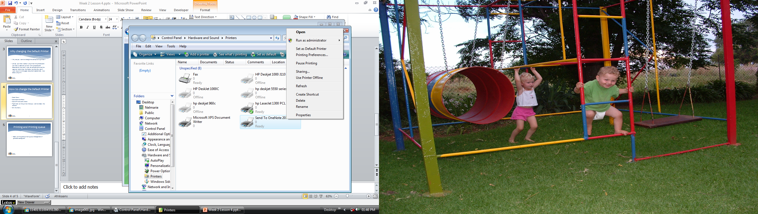
How to change the Default Printer
Start Menu
Go to Control Panel
Go to Printers and faxes
Right click on the printer that you want to make the default
On the menu that appears choose „Set as Default Printer”.

Slide 5
Printing and Printing queue
When you send a document to the printer, the computer stores this file temporarily on the hard disk waiting for the printer to get ready for printing.
When you send a second document to be printed and the first document is not ready to print, these documents will be placed in a queue.

Slide 6
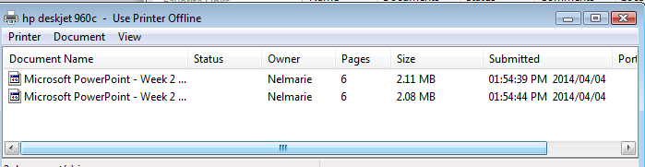
Deleting a document in queue
When you want to delete a document that is already been sent to the printer, you open the print queue,
Control Panel – Printers and faxes – Click on the printer
Click on the file and press the delete key, or open the Document menu and choose Delete.

